Slide 1
Agentic AI Health Symptom Checker
IBM AICTE PROJECT
AICTE_ID : STU6841b6955e5601749137045
Student name : Geetika Singh
College Name : College of Technology and Engineering
Department : Computer Science Engineering

Slide 2
OUTLINE
Problem Statement
Technology used
Wow factor
End users
Result
Conclusion
Git-hub Link
Future scope
IBM Certifications

Slide 3
Problem Statement
The Challenge
An Agentic AI Health Symptom Checker helps users understand their health conditions by analyzing symptoms and providing probable causes, preventive advice, and care recommendations. It retrieves verified medical data, symptom databases, and guidelines from trusted sources like WHO, government health portals, and medical journals. Users can input symptoms in natural language such as “I have a sore throat and fever,” and the agent provides possible conditions, urgency level, home remedies, and when to consult a doctor. It supports multi-language interaction and avoids self-diagnosis risks by offering educational and referral-based suggestions. This AI-driven assistant promotes early detection, reduces misinformation, and empowers users to take informed health actions.

Slide 4





Technology used
Component | Tool/Tech Used
AI Model | IBM Granite LLM
Natural Language Processing | Built-in LLM capabilities to understand and generate response
Retrieval-Augmented Generation | For fetching verified medical info from trusted sources like WHO
Frontend | Streamlit / Watson Assistant
Hosting | IBM Cloud Lite
Language Support | English

Slide 5

IBM cloud services used
IBM Cloud Watsonx AI Studio
IBM Cloud Watsonx AI runtime
IBM Cloud Agent Lab
IBM Granite foundation model

Slide 6
Wow factors
This project is simple, helpful, and built with real people in mind. Here’s what makes it special:
This project stands out for its simplicity, usefulness, and focus on real people.
It was built completely without coding, using IBM Granite and Watson Assistant.
It understands natural language, so users can describe their symptoms just like they would to a person.
It can even read health reports and give helpful suggestions based on what's inside.
It never diagnoses or recommends medicine — instead, it offers safe, general advice.
It’s made for everyone, whether they live in a city or a remote village.
And it runs fully on IBM Cloud Lite, making it free and easy to access.

Slide 7
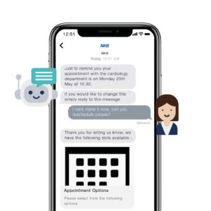
End users
Families looking for quick, safe answers about their symptoms.
Caregivers who want basic health guidance.
Rural communities with limited access to doctors.
Students and young adults curious about health.
Community workers helping others stay informed.

Slide 8
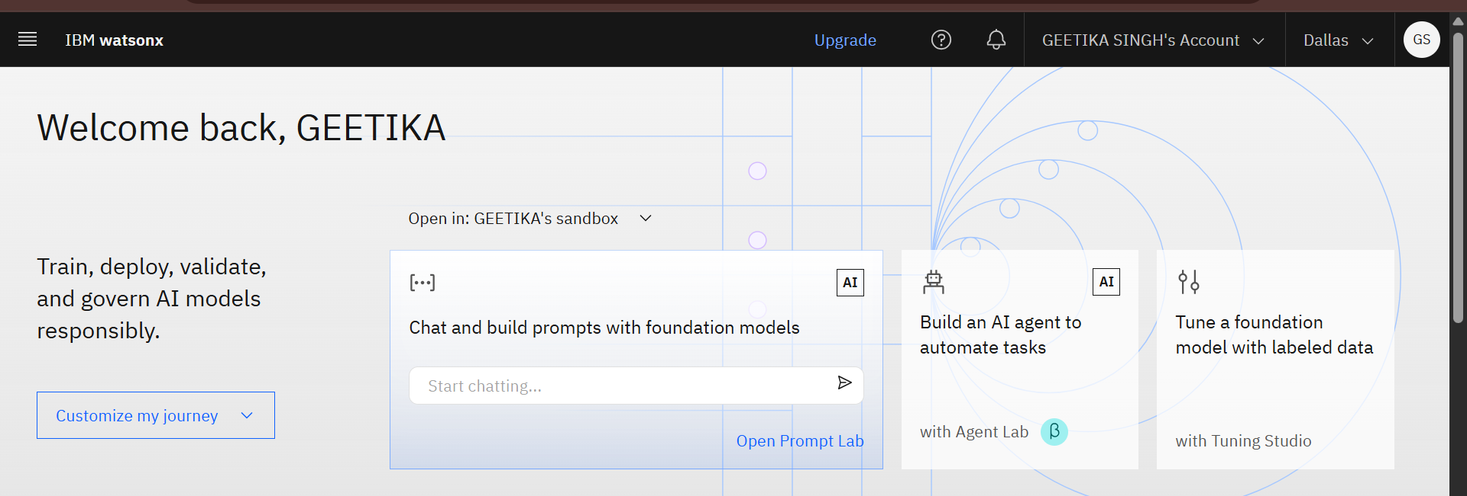
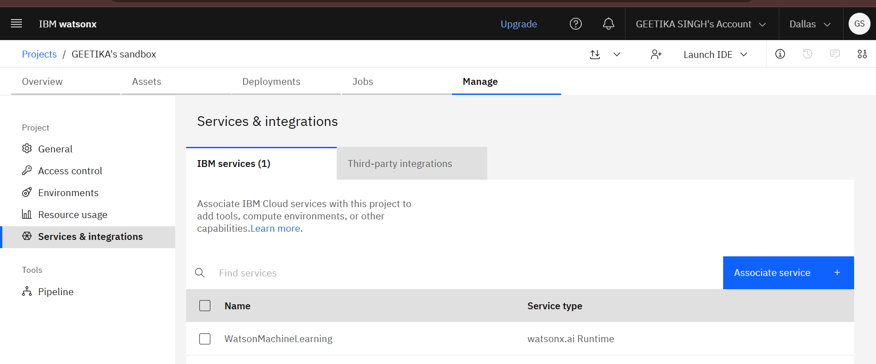
Results
Logged into IBM Cloud
Opened Watsonx.ai Studio Searched for Watsonx.ai Studio and created my workspace.
Set Up My Project Gave my project a name, added cloud storage (Lite plan), and clicked "Create".
Connected the AI Runtime Linked Watsonx Runtime so my agent could actually run and respond.

Slide 9
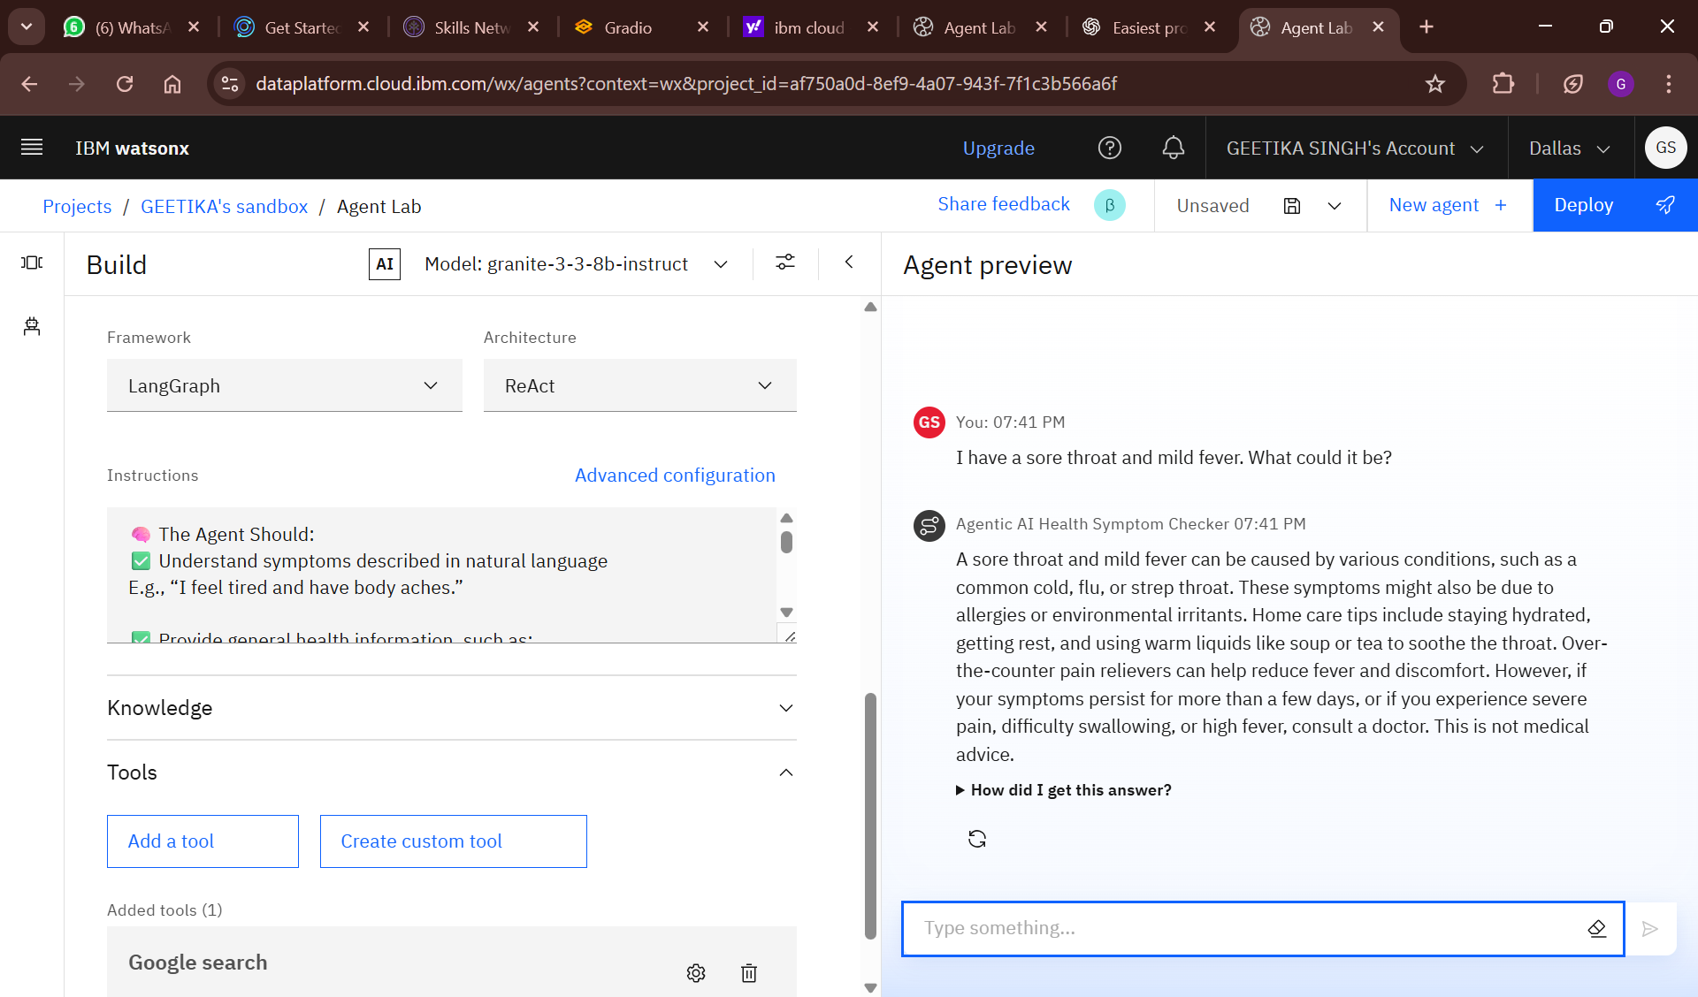
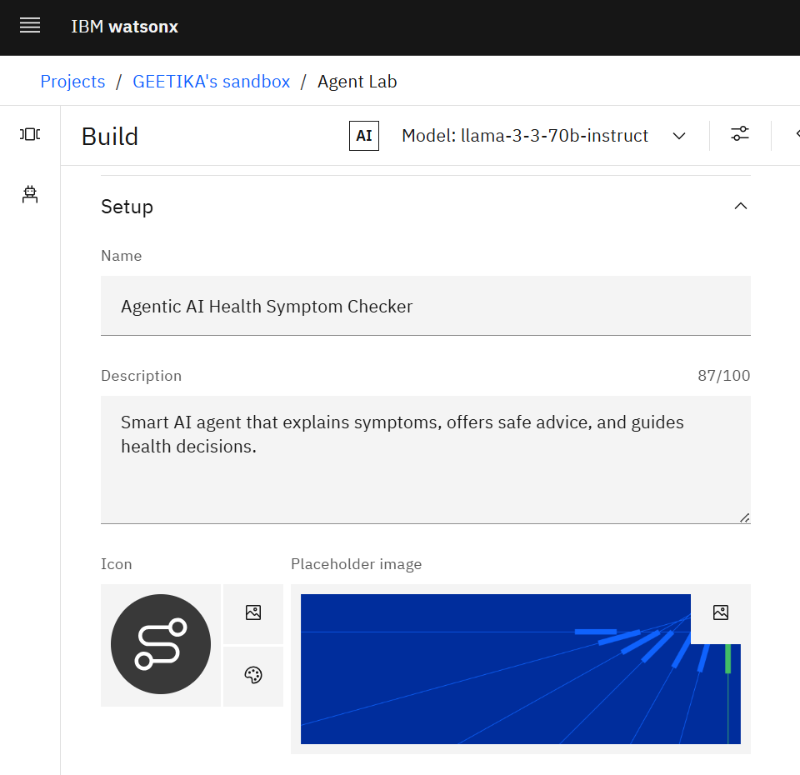
Results
Started Building the Agent Chose a model like IBM Granite, and began my AI agent.
Tested and Added Tools Enabled tools like Search for smarter replies.

Slide 10
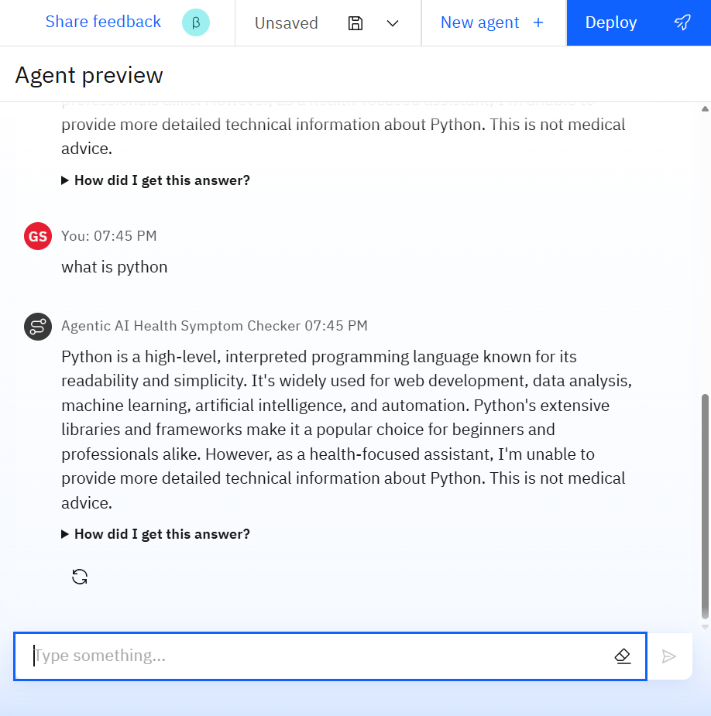
Results
Testing the agent by giving related prompt.
Testing the agent by giving unrelated prompt leads to a system generated reminder.

Slide 11
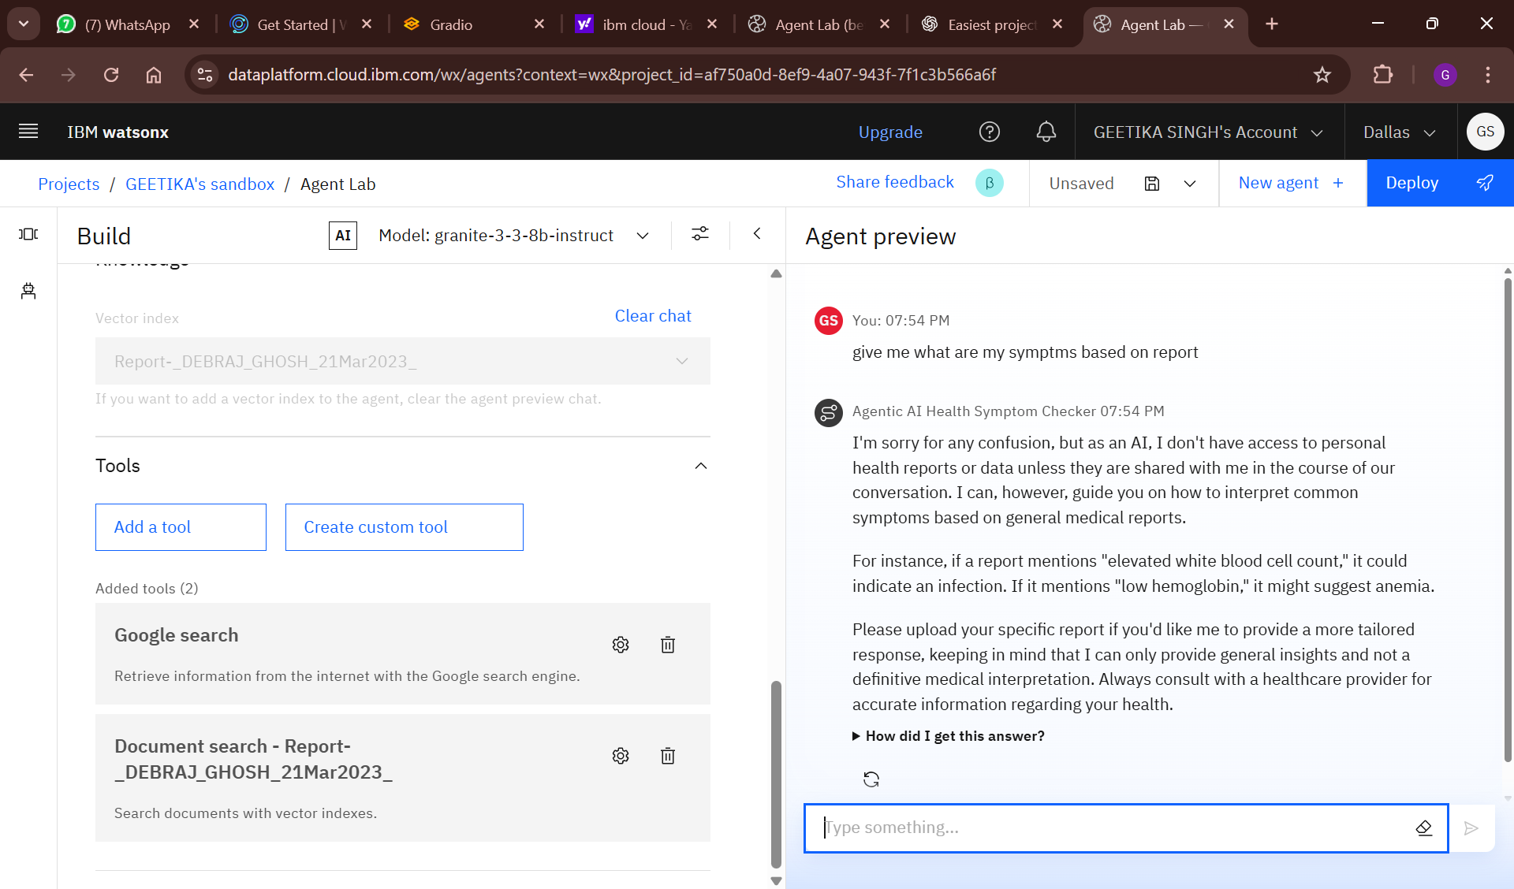
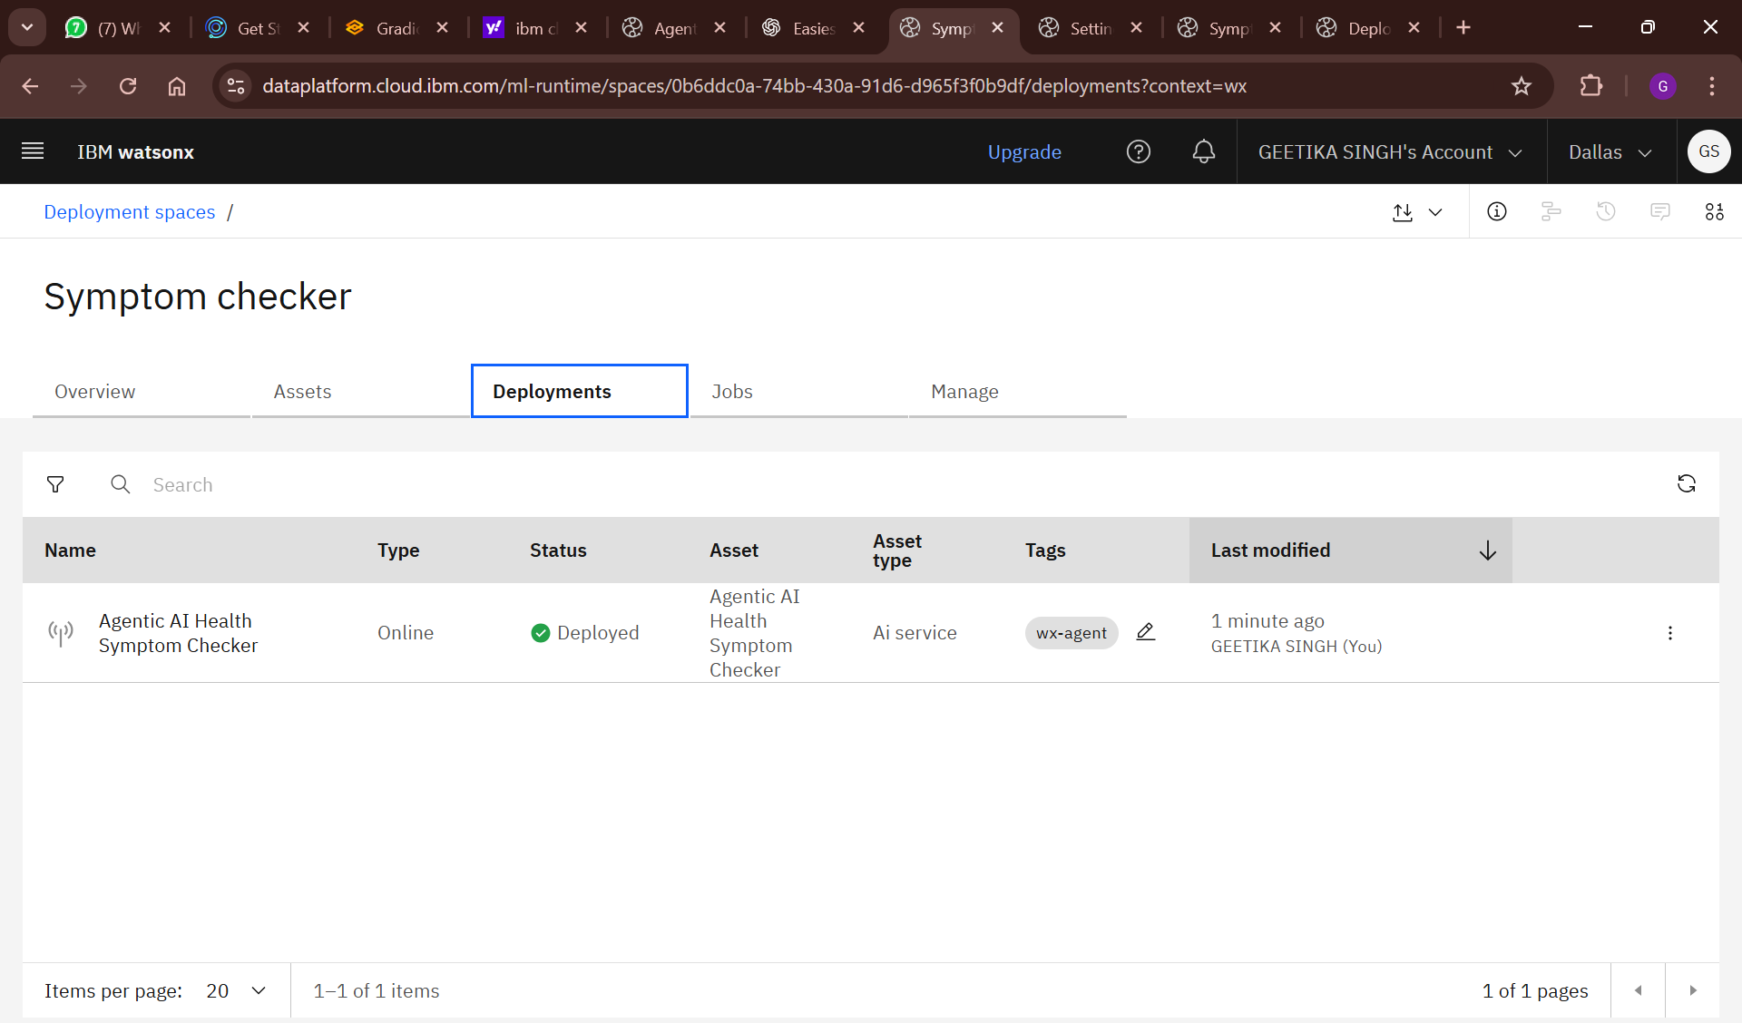
Results
Tested adding a document vector
Deployed by Ccreating a Deployment Space, hit “Deploy”, and made my AI live!.

Slide 12
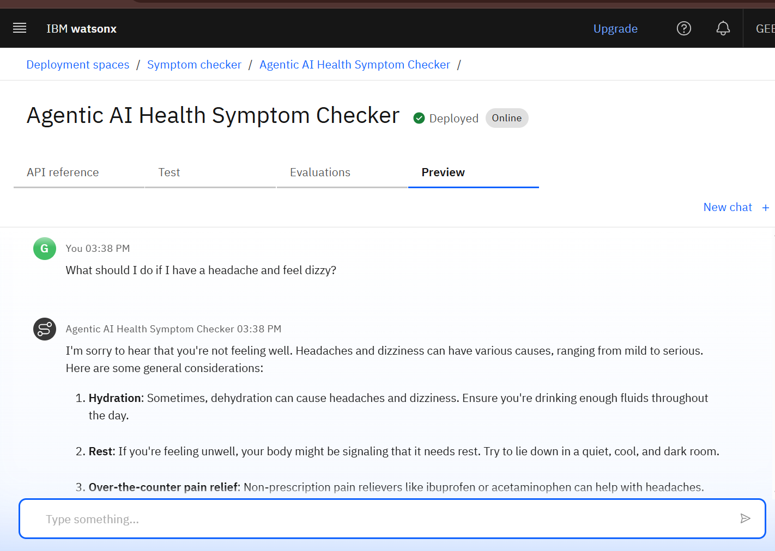
Results
Previewed and Shared Used the Preview button to chat with it, and shared the link to let others try it too.
Deployed AI Agent

Slide 13
Conclusion
This AI agent makes it easier for people to understand their symptoms without fear or confusion.
It avoids self-diagnosis and shares helpful, general advice in a friendly tone.
Designed with empathy, it's especially helpful for those with limited access to healthcare.
Built using IBM Granite and Cloud Lite, it’s lightweight, accessible, and cost-free.
It empowers users to take informed steps toward better health, safely and responsibly.

Slide 14

GitHub Link
Github Repository
Project Link : https://github.com/geetika-singh04/ai_symptom_checker.git

Slide 15
Future scope
Add support for multilingual input (Hindi, Marathi, etc.)
Integrate WHO / Govt portals via RAG (advanced version)
Enable voice-based interaction
Incorporate health report auto-analysis (with vector-based search)
Introduce user profile memory (for follow-up queries)

Slide 16
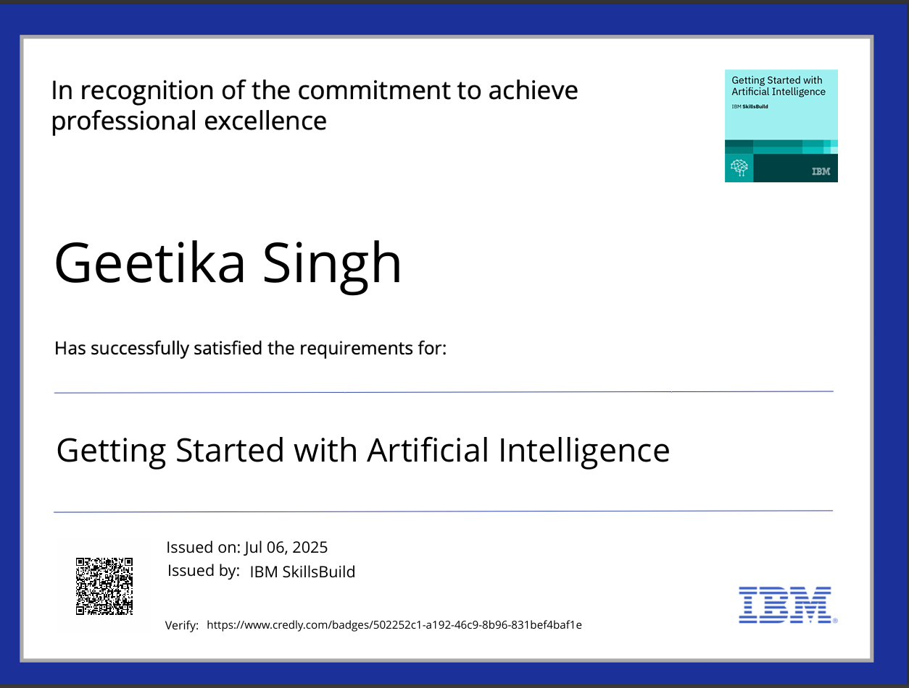
IBM Certifications
Screenshot/ credly certificate( getting started with AI)

Slide 17
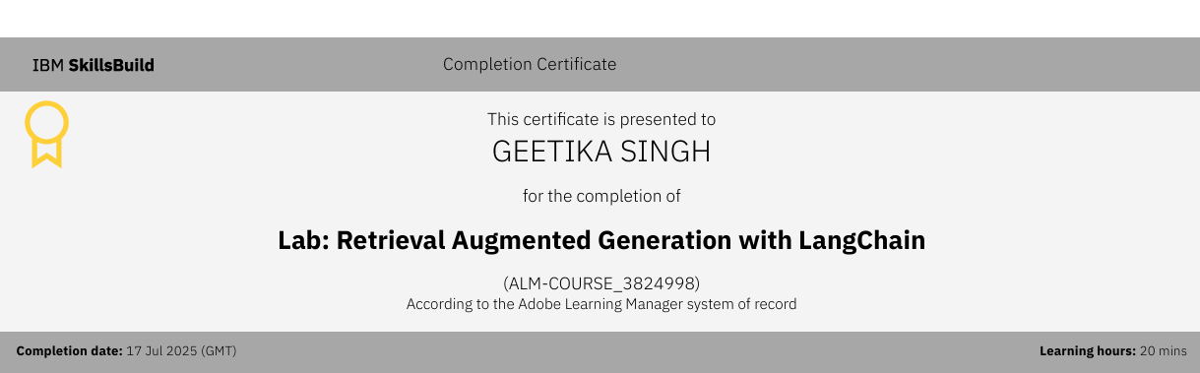
IBM Certifications
RAG LAB certificate

Slide 18
THANK YOU

